Slide 1
Profit Analysis
Name : Karunakaran R
Email id : rkarunakaranraja@gmail.com
Batch : 12th May CDA
Project id : PTID-CDA-SEP-25-722

Slide 2
Agenda
Introduction
Objectives
Dataset
Tools & Methodology
Excel
Tableau Dashboard
Insights
Recommendations
Conclusion

Slide 3
Introduction
Dataset contains 50 startups from New York, California, Florida.
Features: R&D Spend, Administration Spend, Marketing Spend, State, Profit.

Slide 4
Objectives
Identify factors affecting Profit.
Predict Profit for given inputs.
Visualize insights using Tableau.

Slide 5
Dataset
Total Records: 50
Attributes:
R&D Spending
Administration Spending
Marketing Spending
State
Profit

Slide 6
Tools & Methodology
Excel → Regression Analysis and Predict the profit for new input values.
Tableau → Visualizations & Dashboard.

Slide 7
Excel
Regression Analysis
Dependent Variable : Profit
Independent Variables : R&D, Administration, Marketing
Regression Equation : Profit = Intercept + (Coeff _ R&D*R&D _ spending) + (Coeff _ Admin*Administration _ spending) + (Coeff _ Marketing*Marketing _ spending)
Profit Prediction
Predicted results using regression equation:

Slide 8
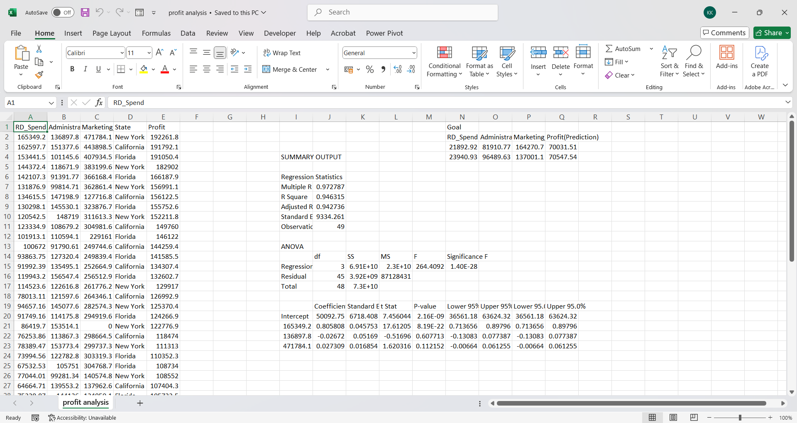

Slide 9
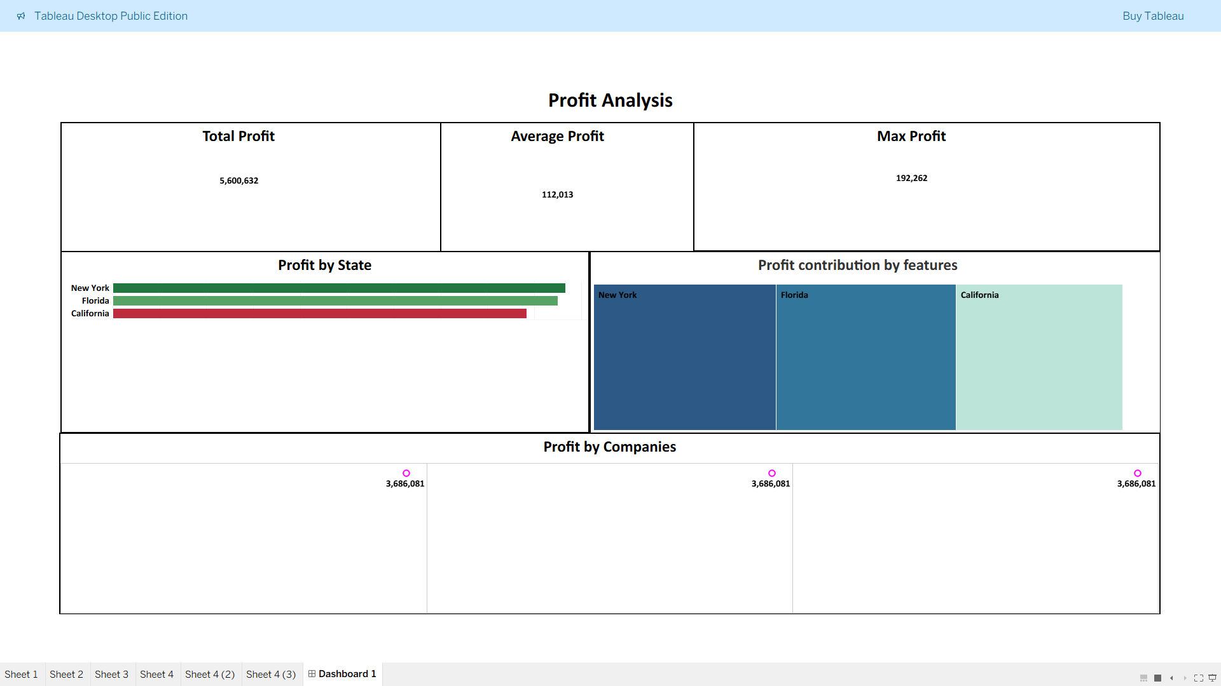
Tableau dashboard

Slide 10
Insights
R&D spending is the biggest profit driver.
Marketing has moderate impact.
Administration cost has minimal effect.
Certain states contribute more to profit.

Slide 11
Recommendations
Increase R&D investment for long-term profit.
Optimize marketing efficiency.
Control administration expenses.
Focus on high-profit states for expansion.

Slide 12
Conclusion
Regression analysis identified R&D as the key factor.
Tableau visualizations confirmed insights.
Predictions help in future planning.
Data-driven strategy ensures better profit allocation.

Slide 13
Thank you

